Slide 1
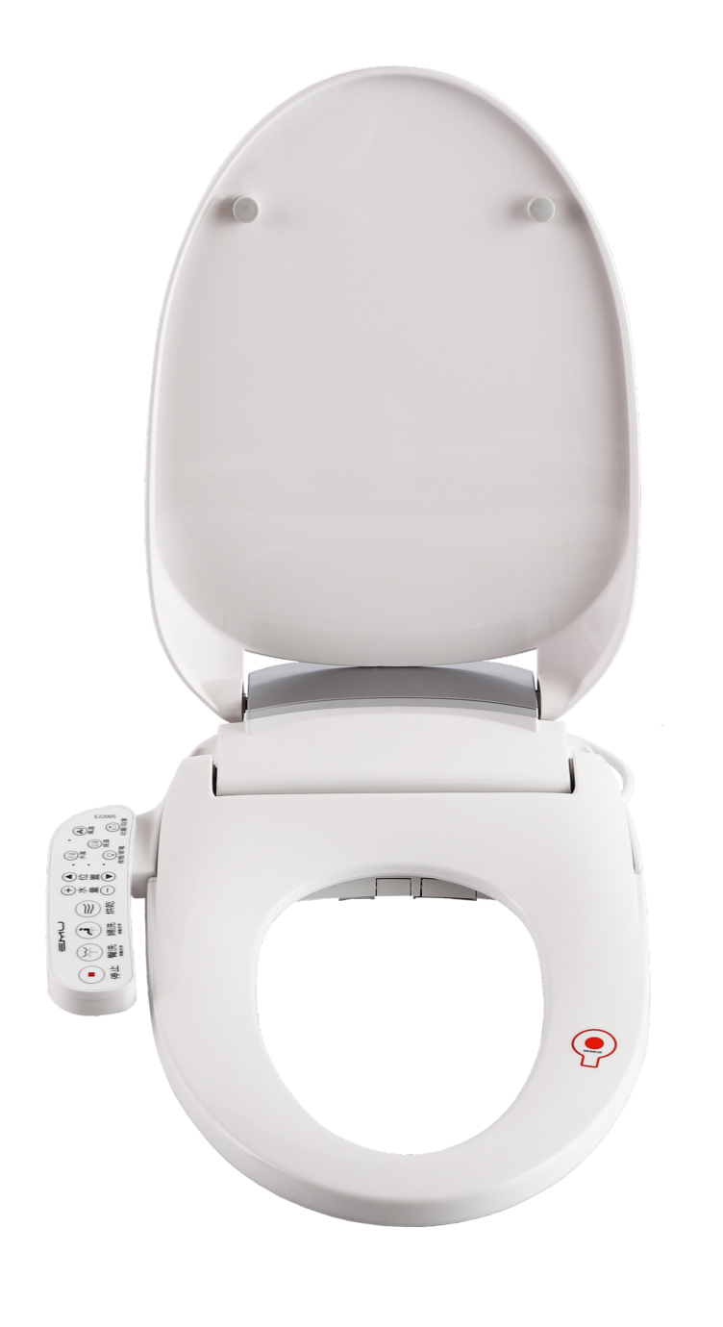
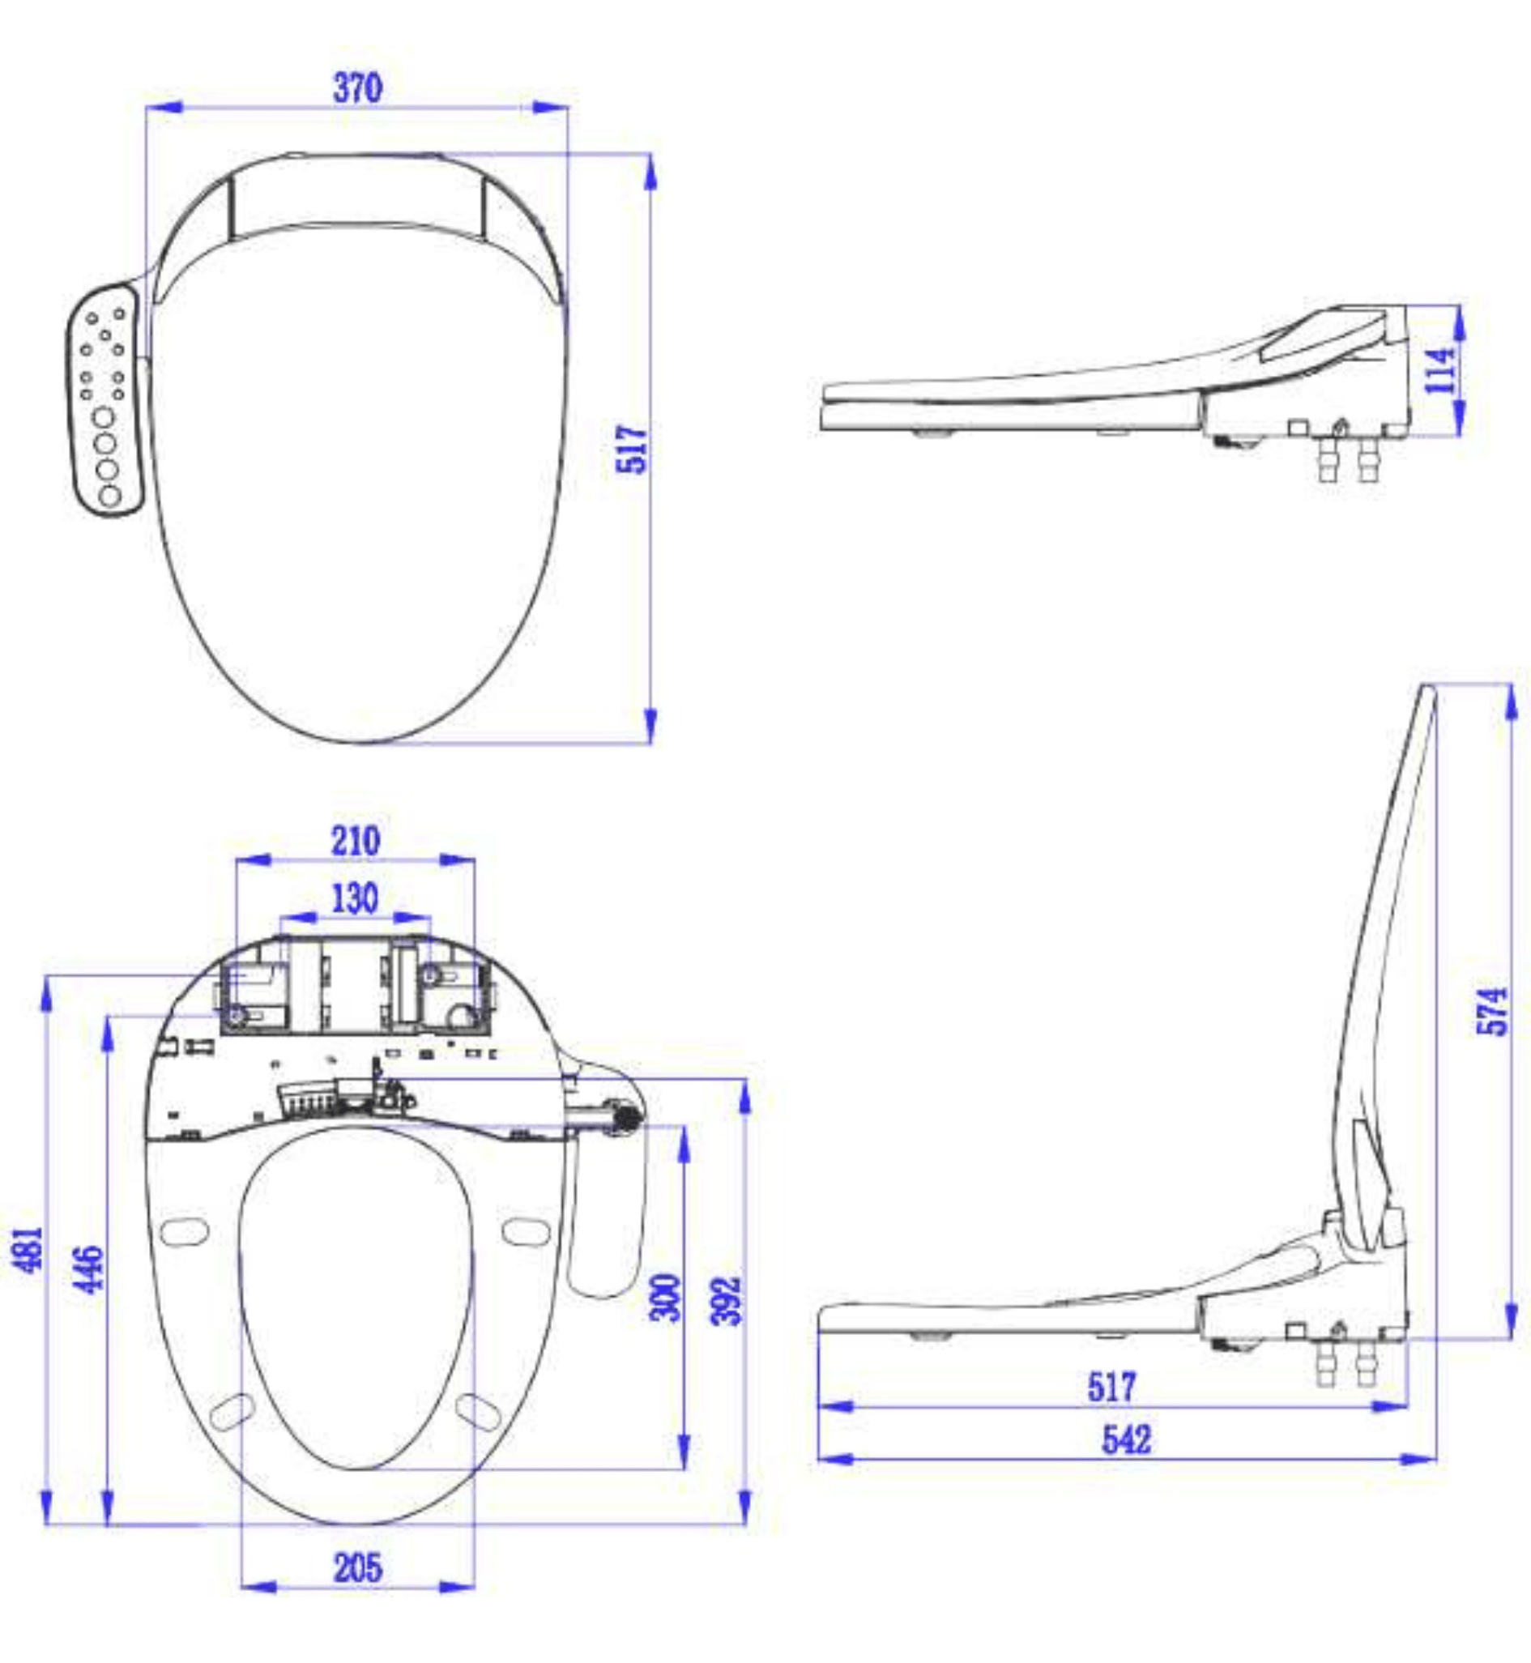
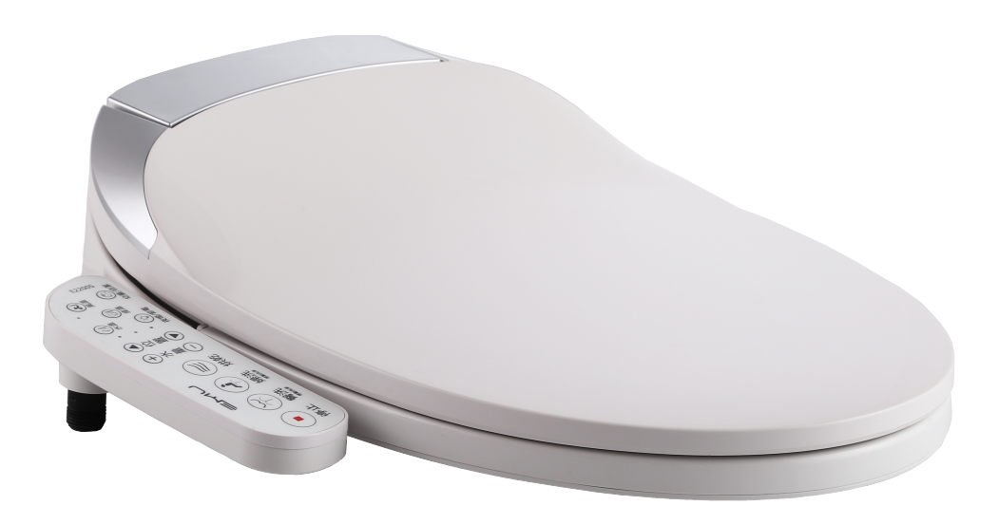


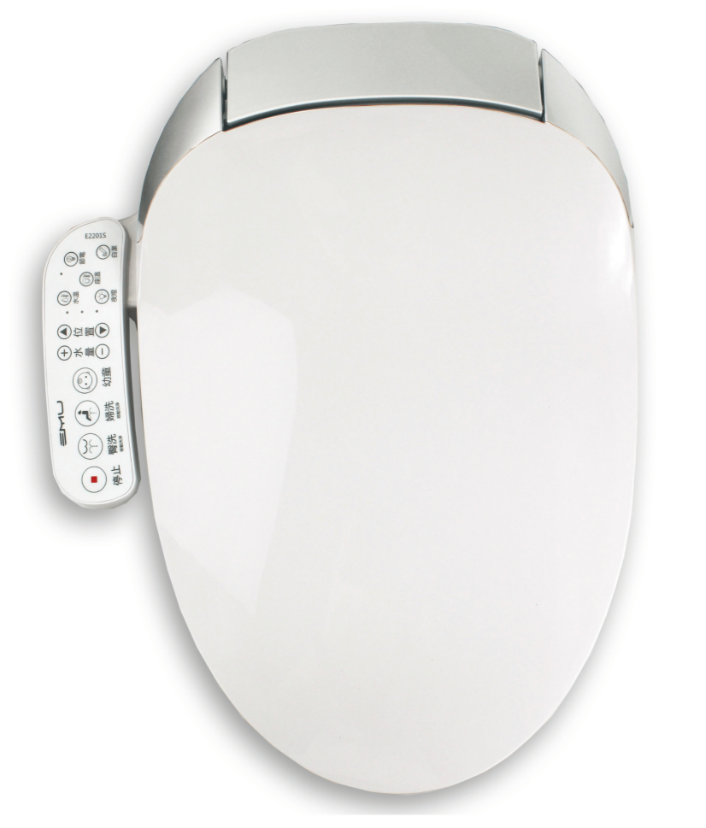
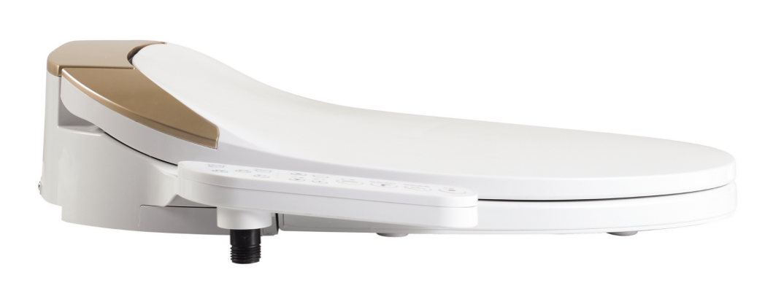
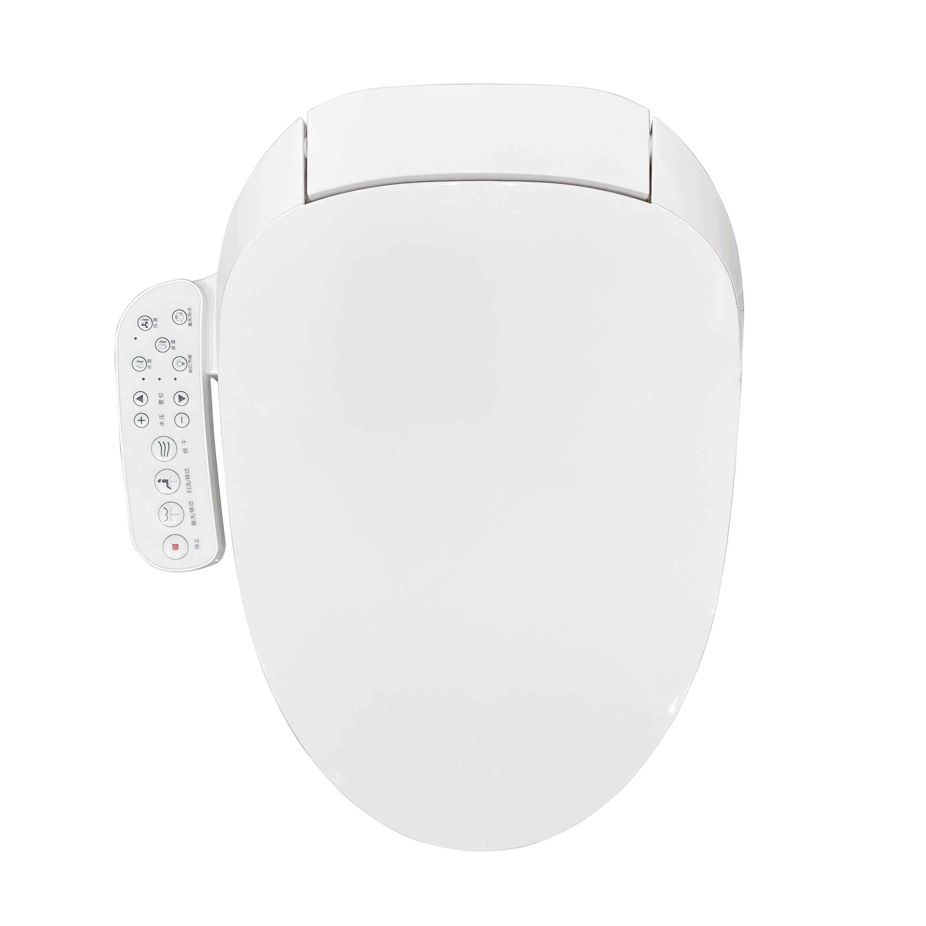
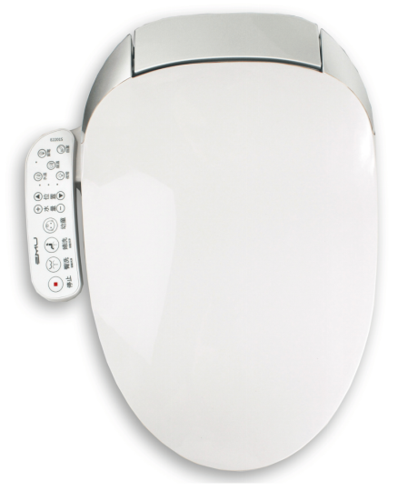
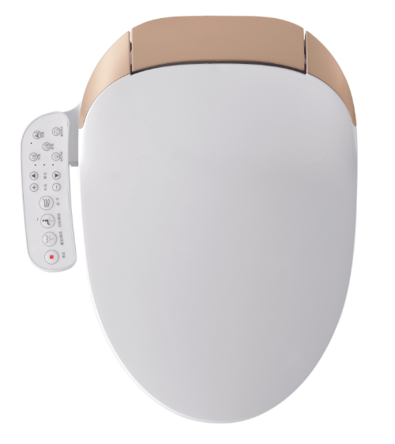
E2200
Smart Cover
PP FLAME RETARDANT PLASTIC
SHAPE: V SHAPE
SIZE: 517*370*114mm
WEIGHT(With Package): 5.16kg
FUNCTIONS:
Front/Rear Wash, Oscillating/Pulsating Spray,
Heated Seat, Warm Air Dryer, Soft Close, LED Night Light
Adjustable Water Temperature and Pressure, Adjustable Air Temperature, Adjustable Nozzle Position, Adjustable Seat Temperature
IPX4 Waterproof, Electrical Leakage Protection, Side Control Panel, Galvanized ABS Nozzle, Nozzle Cleaning Wand, Changeable Nozzle
white | silver | gold

